Slide 1

Math Notation Helper
IOS Development Group 62
Notes:
Introduce ourselves
We are presenting Math Notation Helper, an app that helps Students learn and understand Math Notation.
Why are we doing it ? …. (next slide)

Slide 2
Problem Statement
Australia is falling behind at Mathematics
Mathematics is critical for the 21st Century
Notes:
Australia’s student mathematics performance has been falling quickly for the last 25 years
1/3 of people finish school with only basic mathematical knowledge, and only 1/3 can apply it to somewhat complex tasks
Advanced Mathematics enrolments for years 11 and 12 that teach important concepts such as Calculus are on the steady decline.
These skills are critical for new and emerging technology such as Machine Learning, Artificial Intelligence and Data Science that are starting to boom in a similar way to what IT was in the 90’s, as well as being important to understand things like coding.
(Spend ~1 min here)

Slide 3
Source: https://www.theaustralian.com.au/national-affairs/education/students-slide-in-global-maths-and-science-rankings/
Notes:
We’ve moved behind Kazakhstan in maths, where the Borat documentary was filmed, as well as Hungary, the Czech Republic and Sweden.
(Spend < 30 seconds here)

Slide 4
How we will help
1
THE LANGUAGE OF MATHS IS HARD TO LEARN
1
OUR APP CONVERTS IT TO ENGLISH
Textbooks often explain proofs with more jargon
Students can get proofs translated back into words they can understand to help them learn notation
2
TEACHING QUALITY
2
VISION
Teachers often go straight into problems without explaining things properly, or don’t understand
This app can be a tool for Teachers and Students to learn and teach
3
300 PAGE $200 TEXTBOOKS ARE THE PAST
3
MODERN RESOURCES
Students need modern learning tools they can relate to
Students can go into the app and learn when they pickup their phone to service their IPhone addictions
Notes:
How we will help ( refer slides)
(Spend ~ 1 min here

Slide 5




Helps Students By:
SEARCH FUNCTION
Lookup math symbols by name or symbol
Custom math keyboard sits above IOS Keyboard
SYMBOL AND COMMON FORMULA DEFINITIONS
Math Notation
Helper
Access definitions for symbols and common formulas
Load external URL’s (e.g. Wikipedia) for more information
Ability to save favourites to device locally
DYNAMIC FORMULA TO ENGLISH TRANSLATIONS
Dynamic formula page translates symbol meanings into sentences as you type!
Interactive displays with real-time translations for common math functions
e.g. Sigma notation to English for Summation, Product
FIREBASE INTEGRATION
Firebase integration lets users access new content instantly
MVP can be extended to allow users to create and save their own content
Notes:
The functions our app has that helps to solve this problem!
(Spend ~ 1 min here

Slide 6
DEMO
Math Notation Helper
Who worked on…
Who will demo…
Who you can ask about…
25 %
25 %
25 %
25 %
Peter
Wenze
Jiazheng
Le Cai
Source Math Data
CSV / Dictionary Data Model
Summation / Product Views
Initial App Concept
Custom Keyboard
Initial UI Prototype
View Structure / Layout
Professional UI Design
Search Functions
Firebase Integration
Favourites Function
Dynamic Formula Translation
Common Formula Views
Formula Detail View
Open External URL’s from App
Initial Data Model
Search Function
Firebase Integration
Symbol Detail View
Table View Structures
Notes:
DEMO – Spend 10 mins here
We can agree who presents what, and who answers questions

Slide 7
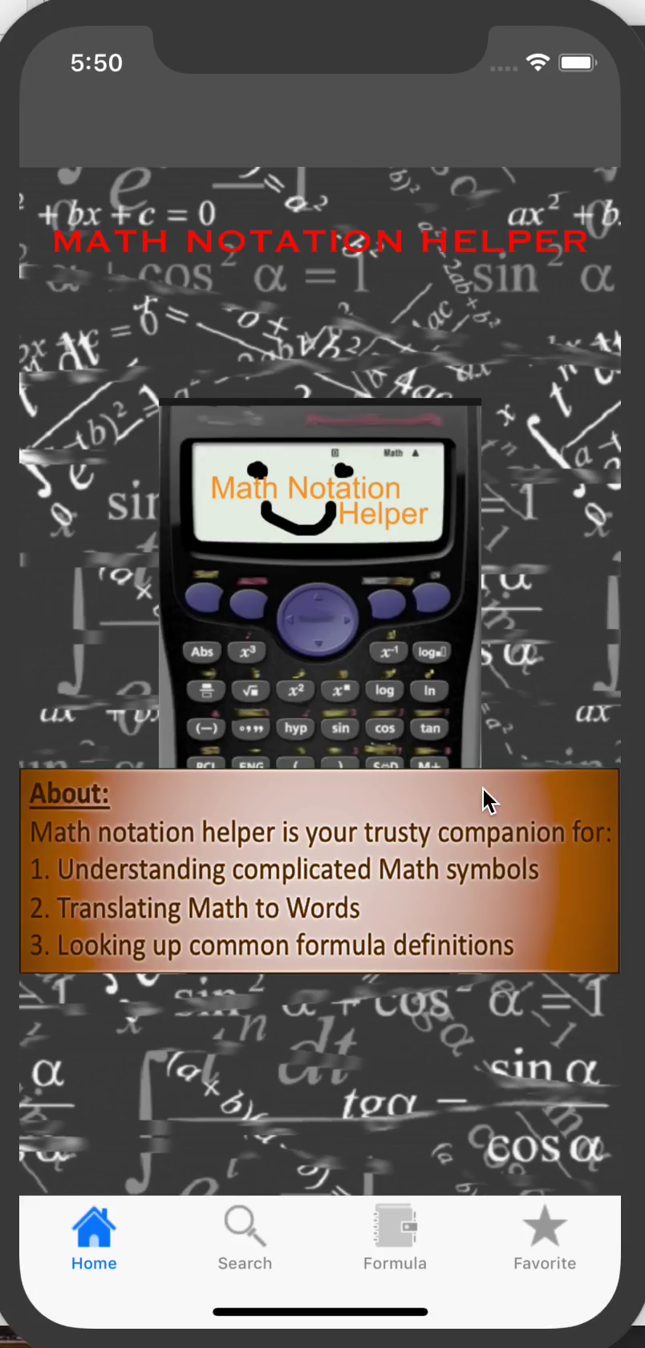
TEAM APPROACH
IOS Group 62
IDEA PHASE
REFINE FEATURES
REVIEW
Agree on concept
Brainstorm app & workflow
Action early MVP feedback
Refine Trello actions
Merge final changes
Debug and test on different IOS builds
7th May
14th May
21 May
28 May
4 June
PROTOTYPE PHASE
‘CRUNCH’ TIME
Setup GitHub
Setup Trello Board
Build Initial Data Model & Views
Commit to build
De-scope some features
Test and Finalise
Notes:
Team Approach
(Spend ~ 1 min here)

Slide 8
Success Tools
Plan
Agree
Help
Commit
Review
210k
50k
1M
followers
followers
likes
MOCKPLUS
Daily Scrum Huddles
TRELLO
Rapid UI Layout Prototyping
When we met @ Uni twice per week
Daily Facebook chats
Task Prioritisation
Scope Managemnet
Notes:
(Spend ~ 30 seconds - 1 min here)

Slide 9
WHERE TO FROM HERE
(If we go large)
MVP
PRODUCT DEVELOPMENT
Refine idea based on MVP Feedback
Get feedback and requirements from schools, universities, teachers and students to refine and build a final product
MVP
INVESTORS
DEVELOP
TO MARKET
PITCH TO INVESTORS
MARKET LAUNCH
Get Funding and do it properly
Launch on App Store early 2019
School/University stalls, road-shows & promotions
Notes:
Next steps (in our fictitious/pretend journey)

Slide 10
Questions?
Thanks for a great semester
We would like to thank you guys for the opportunity to present to you today.
Notes:
Challenges
Making sure we broke the problem down into pieces that we could work on separately, without overlapping code
Understanding what we could do and by when … how much work was involved
Learning how to communicate well so that we all had the same understanding of an idea e.g. drawing it on the whiteboard and making sure it would actually work in practice before we started getting feedback from each other

